Slide 1


Java Training
Trainer: Priya

Slide 2


PRE - REQUIREMENT?
System
Interest
INTEREST
TIME

Slide 3
PROGRAMMING ?
TO CREATE
SOFTWARE: Not Physical
HARDWARE: Physical -> mobile, laptop, television almost everything

Slide 4
Programming Language?
1. to interact with computer
2. diff ways
3. universal
4. Eg: ATM, bank transaction,electricity, social media, 5. can safeguard our data
http://helloworldcollection.de/

Slide 5
Session - 1 POA
Introduction to what is need of software –
what are programming languages,
UI technologies
servers,databases etc
Java as one of programming language.
Introduction to java
Basics of Java
What is JDK,JRE and JVM
Internal Architecture of JVM
Data Types In Java
Introduction to IDE's like eclipse/intellij/STS with simple helloworld program and compile & running helloworld program in IDE along with basics on compiler & interpreter

Slide 6
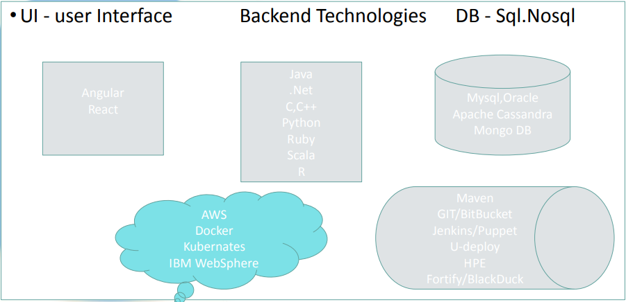
Intro to Software

Slide 7
Intro to Java & Basic of Java
•History of Java
•Java programming language is named JAVA. Why?
•Java terminology
• Platform Independent
• Features of java
• Simple hello World Program & explanation of each and Every Instruction in program.

Slide 8
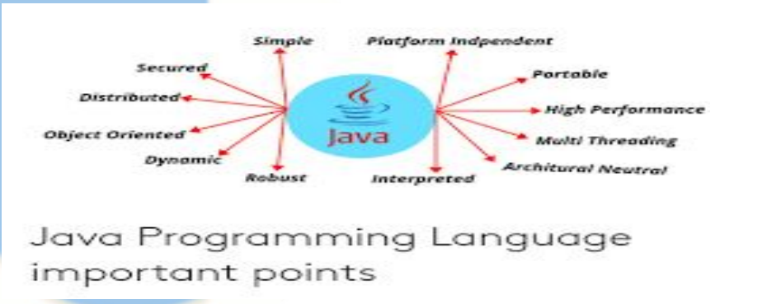
JAVA FEATURES

Slide 9
HISTORY
1995 - sun micro - James Gosling
oak- green - java Coffee - java
10 million developers
use: 3 billion mobile devices
later owned by oracle 6. version 1.x

Slide 10
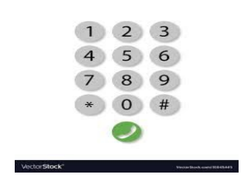
TO GET STARTED
1 JAVA JDK ->(correct or not ?)
2 IDE (whatsapp) or Online Compilers

Slide 11
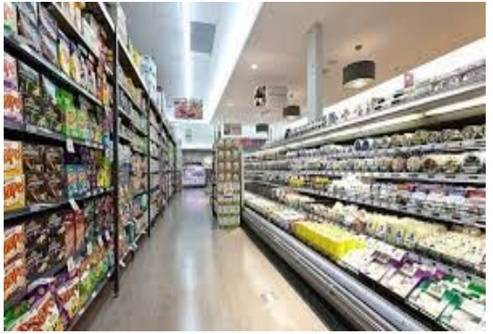
JAVA PROGRAM
.java file structure ?
1. package
2. class
3. method

Slide 12
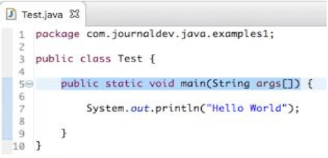
.java file
code structure

Slide 13
JAVA INTRO BLOGS
https://www.javatpoint.com/java-basics https://www.tutorialspoint.com/java/index.htm https://www.w3schools.com/java/java_intro.asp https://www.geeksforgeeks.org/introduction-to-java/?ref=lbp

Slide 14
Eclipse/STS/IntelliJ Tools
•Intro to IDE’s
• Eclipse
• STS
•IntelliJ
•Difference Between Compiler & Interpreter
•Hello World Program - Packages,Libraries,Class& interfaces,Statements.

Slide 15
Simple Program
// Your First Program
Package com.sample.learning;
import java.lang.*;
import java.util.*;
public class HelloWorld {
public static void main(String[] args) {
System.out.println("Hello, World!");
}
}

Slide 16
HOW JAVA CODE GETS EXECUTED
.java file -> java compiler -> .class file
[platform independent -> jvm](native code)

Slide 17
Java Edition
SE -> (using now)
EE -> (company)
ME -> (mobile)
JAVA CARDS -> (smart card)

Slide 18
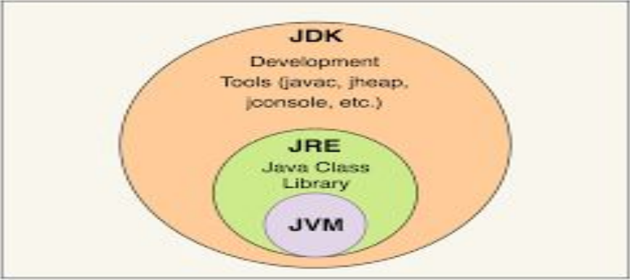
JRE + JDK + JVM

Slide 19
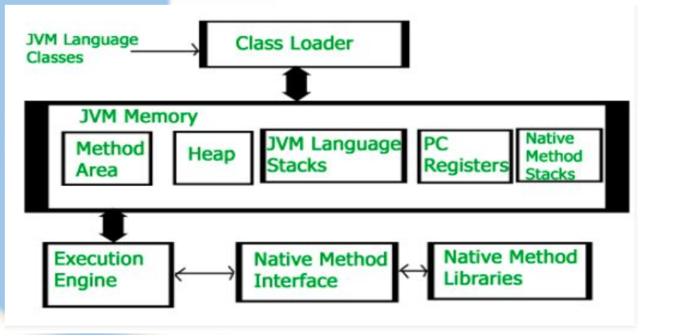
JVM

Slide 20
TODAY’s AGENDA
Java Data Type
String Array functions
loops(if possible)
(theory -> blog -> practice)
operator
naming conventions

Slide 21
DATA TYPES

Slide 22
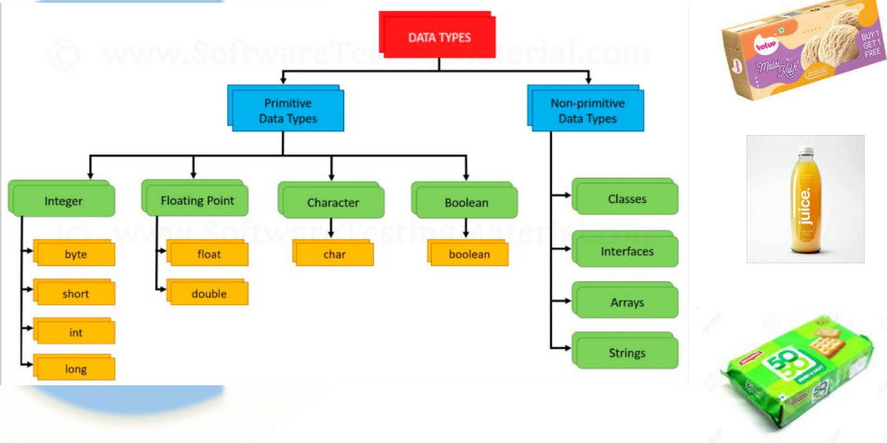
Data Types In Java

Slide 23
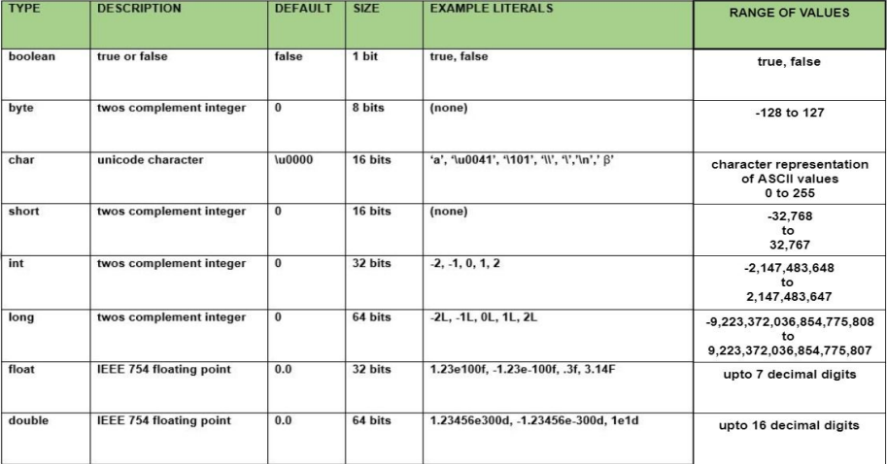
JAVA primitive types

Slide 24
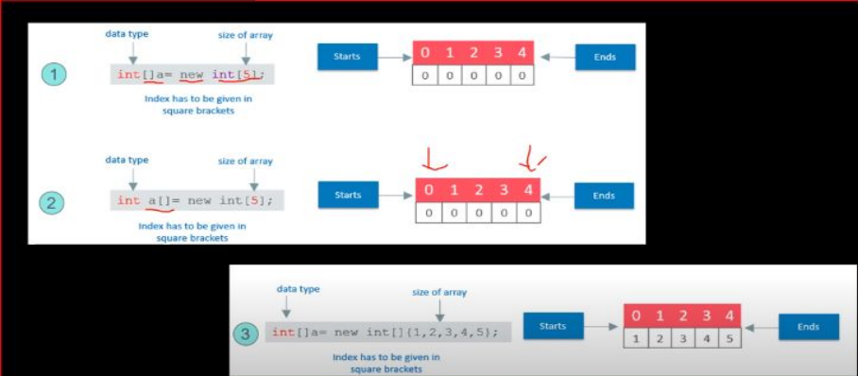
Arrayworking

Slide 25
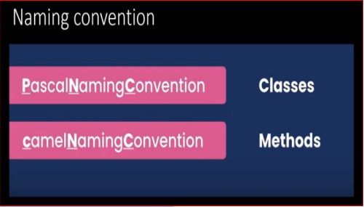
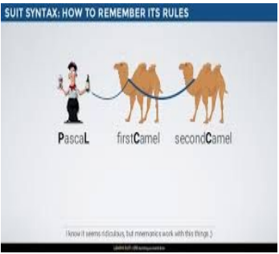
Naming Convention(standard)

Slide 26
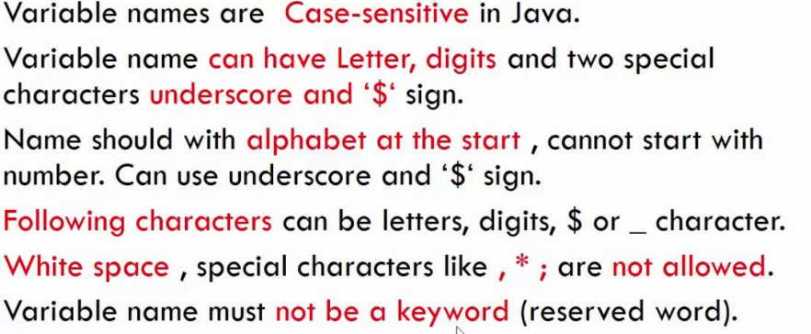
Naming rules for Variables

Slide 27
OPERATOR

Slide 28
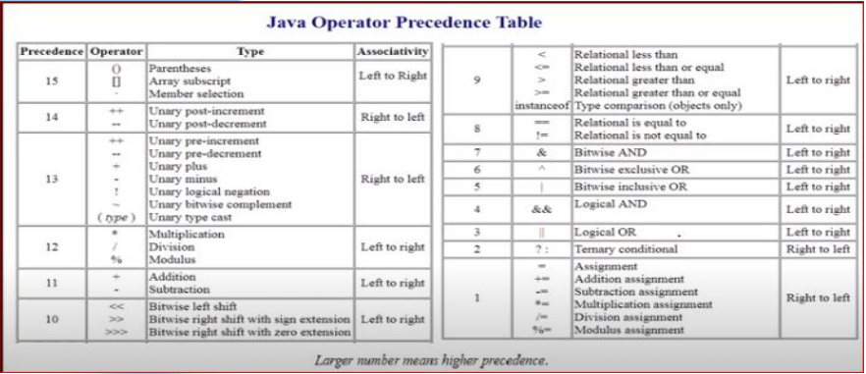

Slide 29
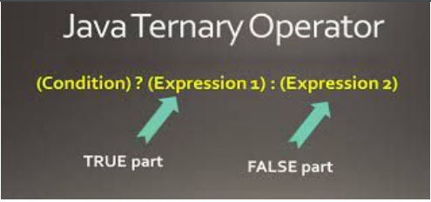

Slide 30
operator qns
int a = 9;
1. a++;
System.out.println (a);
2. a–;
System.out.println (a);
3. ++a;
System.out.println (a);
System.out.println (a++);
System.out.println (a--);
System.out.println (--a);
System.out.println (++a);

Slide 31
https://www.w3schools.com/java/java_data_types.asp https://www.w3schools.com/java/java_variables.asp https://www.w3schools.com/java/java_strings.asp https://www.w3schools.com/java/java_booleans.asp https://www.w3schools.com/java/java_ref_string.asp https://www.w3schools.com/java/java_operators.asp https://www.geeksforgeeks.org/java-identifiers/?ref=lbp https://www.geeksforgeeks.org/variables-in-java/?ref=lbp https://www.geeksforgeeks.org/data-types-in-java/?ref=lbp

Slide 32
Scanner(Inputs)
to get input from user
int number;
Scanner s = new Scanner(System.in);
number = s.nextInt();

Slide 33
FLOW CONTROL
Selection -> if else switch()
Iterative -> while() do while() forEach()
Transfer -> break continue return try-catch

Slide 34
Pattern program
https://www.edureka.co/blog/30-pattern-programs-in-java/

Slide 35
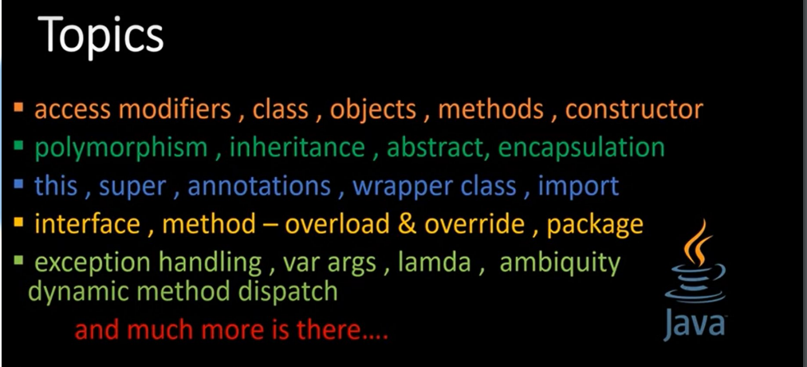
ADVANCED JAVA

Slide 36
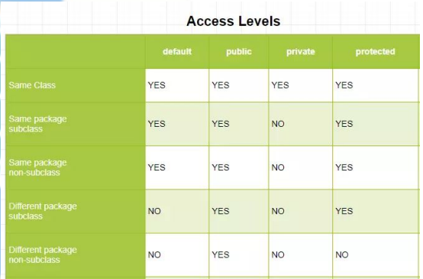
Access Modifier
PUBLIC
PRIVATE
PROTECTED

Slide 37
Access modifier, class, objects, methods
constructor:
in all codes, we seen, by default constructor was present
Whenever class create, constructor automatically will come when it will come means, when we create object

Slide 38
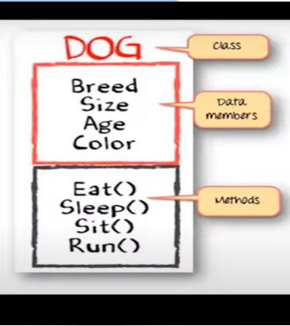

scenario:
Based on customer dog need, we sale dog

Slide 39
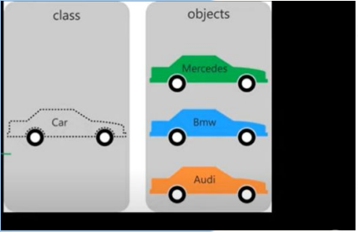
Guess:
Data members? => engine, tyre, speed
Methods? => go,stop

Slide 40
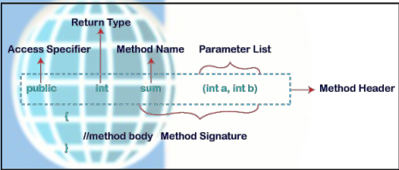
Method Declaration

Slide 41
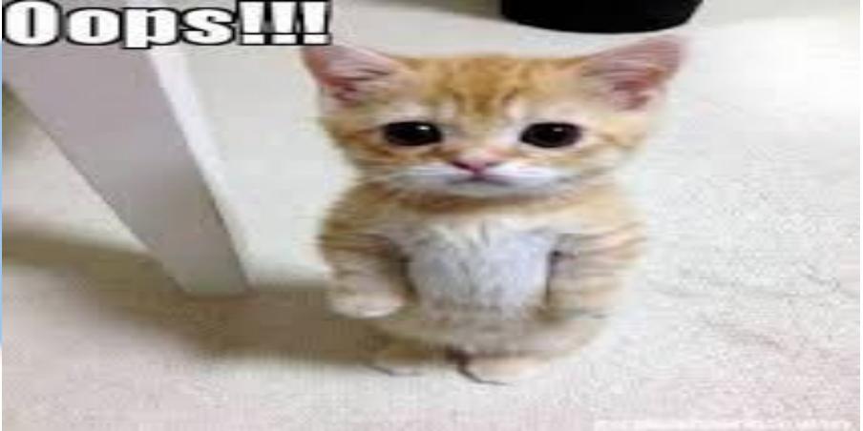

Slide 42
